Slide 1


Slide 2
CONTENTS
P PROBLEM
NP PROBLEM
KNAPSACK PROBLEM
NP-HARD PROBLEM
NP-COMPLETE PROBLEM
FLOYD WARSHALL
DISJOINT SETS

Slide 3
P-PROBLEM
What is a Decision Problem ?
The problems in the P, NP, NP - Complete complexity classes (sets) are all defined as decision problems.
A decision problem is one where the solution is written as a yes or no answer.
For example :
Is 13 a prime number ?
Is 2 and odd number ?
What is a P class problem ?
The class P consists of those problems that are solvable in polynomial time, i.e. these problems can be solved in time O(n^k) in worst-case, where k is constant.

Slide 4
P-PROBLEM
Advantages
P problem : Tractable
Others : Intractable or super-polynomial
Applications
Fractional Knapsack
Minimum Spanning Tree
Linear and Binary Search Algorithms for a given set of numbers
Shortest Path Algorithms; Djikstra, Bellman-Ford, Floyd-Warshall

Slide 5
APPLICATION OF P-PROBLEM
Dijkstra Algorithm
function Dijkstra(Graph, source):
for each vertex v in Graph:
dist[v] := infinity
previous[v] := undefined
dist[source] := 0
Q := the set of all nodes in Graph
while Q is not empty:
u := node in Q with smallest dist[ ]
remove u from Q
for each neighbor v of u:
alt := dist[u] + dist_between(u, v)
if alt < dist[v]
dist[v] := alt
previous[v] := u
return previous[ ]

Slide 6
NP-PROBLEM
What does NP mean ?
NP is the class of decision problems that are solvable in polynomial time on a nondeterministic machine or with a nondeterministic algorithm.
In computational complexity theory, NP (nondeterministic polynomial time) is a complexity class used to classify decision problems.
NP is the set of decision problems for which the problem instances, where the answer is "yes", have proofs verifiable in polynomial time by a deterministic Turing machine, or alternatively the set of problems that can be solved in polynomial time by a nondeterministic Turing machine.
Note that NP stands for “Nondeterministic Polynomial-time”, where nondeterministic means that no particular rule is followed to make the guess.

Slide 7
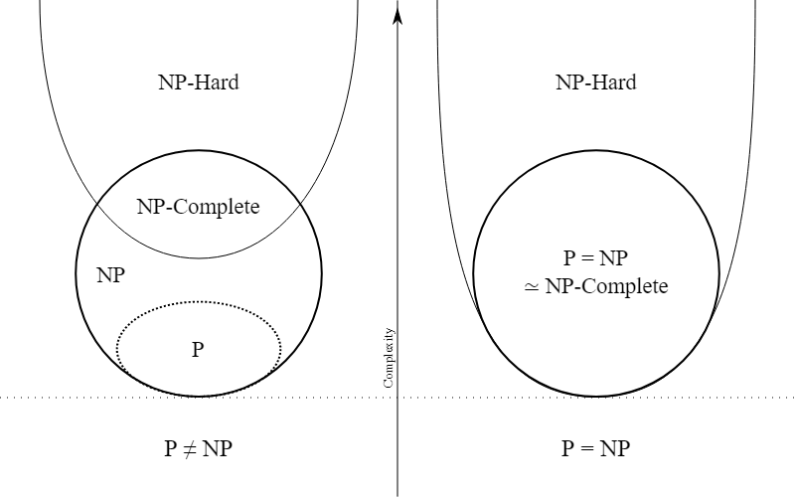
Euler Diagram for P, NP, NP-Complete and NP-Hard Problems

Slide 8
NP INTERMEDIATE PROBLEM
In computational complexity, problems that are in the complexity class NP but are neither in the class P nor NP-complete are called NP-intermediate, and the class of such problems is called NPI.
We expect these algorithms to have an exponential complexity, which is defined as:
T(n) = O(C_1 * k^{C_2 * n}) where C_1 > 0, C_2 > 0 and k > 0
where C_1, C_2 and k are constants and n is the input size. T(n) is a function of exponential-time when at least C_1=1 and C_2=1. As a result, we get O(k^n). For example, we’ll see complexities like O(n^n), O(2^n), O(2^{0.000001*n}) in this set of problems.
There are several algorithms that fit this description. Among them are:
Integer Factorization and
Graph Isomorphism

Slide 9
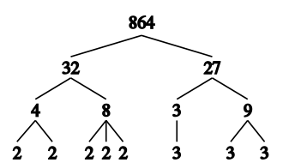
NP-PROBLEM EXAMPLE
Integer Factorization Problem
Problem – Integer factorization is the decomposition of a composite number into a product of smaller integers.If these factors are further restricted to prime numbers, the process is called prime factorization.
Explanation –
Testing whether the integer is prime can be done in polynomial time, for example, by the AKS primality test. If composite, however, the polynomial time tests give no insight into how to obtain the factors. Fermat's factorization method can be used for obtaining the factors.

Slide 10
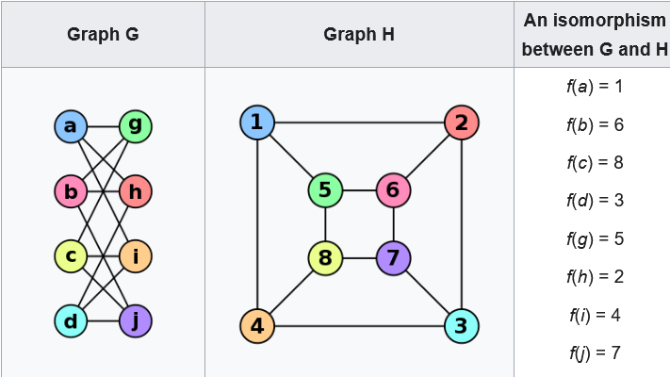
NP-PROBLEM EXAMPLE
Graph Isomerism Problem
Problem – Deciding whether two graphs are structurally identical, or isomorphic.
Explanation –
In graph theory, an isomorphism of graphs G and H is a bijection between the vertex sets of G and H
f : V ( G ) → V ( H )
such that any two vertices u and v of G are adjacent in G if and only if f(u) and f (v) are adjacent in H.

Slide 11
NP-PROBLEM EXAMPLE
Both of these have two important characteristics: Their complexity is O(k^n) for some k and their results can be verified in polynomial time. Those two facts place them all in NP, that is, the set of “Non-deterministic Polynomial” algorithms. Now, formally, we also state that these problems must be decision problems – have a yes or no answer – though note that practically speaking, all function problems can be transformed into decision problems. This distinction helps us to nail down what we mean by “verified”.
To speak precisely, then, an algorithm is in NP if it can’t be solved in polynomial time and the set of solutions to any decision problem can be verified in polynomial time by a “Deterministic Turing Machine“. What makes Integer Factorization and Graph Isomorphism interesting is that while we believe they are in NP, there’s no proof of whether they are in P and NP-Complete. Normally, all NP-Complete algorithms are in NP, but they have another property that makes them more complex compared to NP problems.

Slide 12
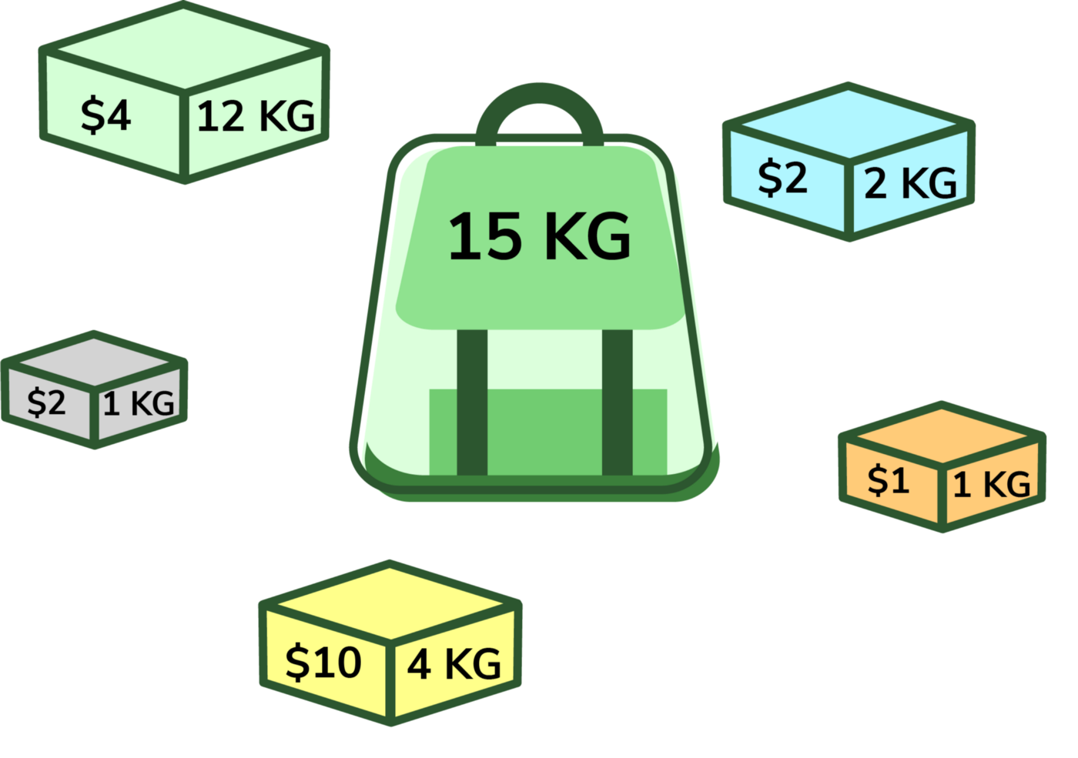
KNAPSACK PROBLEM
The knapsack problem is one of the famous problem in combinatorial optimization and is a NP-Complete problem as NP-Complete is a subset of NP so it is also an NP problem
The problem states that :
Given a set of items, each with a weight and a value, determine the number of each item to include in a collection so that the total weight is less than or equal to a given limit and the total value is as large as possible.
There are two types of knapsack :
0/1 Knapsack Problem : Items are indivisible ; we either take them or not and it is solved by using Dynamic Programming (DP).
Fractional Knapsack Problem : Items are divisible ; we can take any fraction of an item and it is solved by using Greedy Algorithm.

Slide 13
0/1 KNAPSACK
Why is it called 0/1 knapsack Problem ?
Each item is either taken or not taken.
Cannot take a fractional amount of an item.
Cannot take an item more than once.
Greedy Approach doesn't ensure an optimal Solution.
Complexity Analysis :
Time Complexity : O(n*w).
where ‘n’ is the number of weight element and ‘w’ is capacity.
Auxiliary Space: O(n*w).
The use of 2-D array of size ‘n*w’.
Pseudo Code :
Dynamic-0-1-knapsack (v, w, n, W)
array m[0..n, 0..W];
for j from 0 to W do:
m[0, j] := 0
for i from 1 to n do:
m[i, 0] := 0
for i from 1 to n do:
for j from 0 to W do:
if w[i] > j then:
m[i, j] := m[i-1, j]
else:
m[i, j] := max(m[i-1, j], m[i-1, j-w[i]] + v[i])

Slide 14
FRACTIONAL KNAPSACK
In this case, items can be broken into smaller pieces, hence we can select fractions of items, i.e
0 ⩽ xi ⩽1
There are n items.
Weight of ith item wi>0.
Profit for ith item pi>0 and capacity of the Knapsack is W.
Complexity Analysis :
If the items are already sorted into a decreasing order of pi/wi, then the while loop takes a time in O(n).
Therefore, the total time including the sort is in O(nlogn).
Pseudo Code :
Fractional Knapsack (Array v, Array w, int W)
1. for i= 1 to size (v)
2. do p [i] = v [i] / w [i]
3. Sort-Descending (p)
4. i ← 1
5. while (W>0)
6. do amount = min (W, w [i])
7. solution [i] = amount
8. W= W-amount
9. i ← i+1
10. return solution

Slide 15
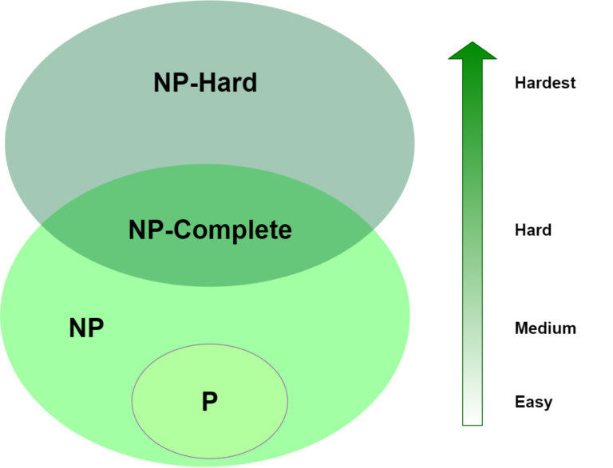
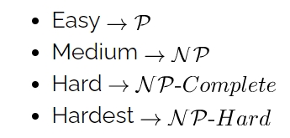
NP-HARD
“NP- Hard “is basically means “at least as hard as any NonDeterministic polynomial problem” although it might be harder.

Slide 16
NP-HARD
A problem is NP-HARD if all problems in Nondeterministic Polynomial are polynomial time reducible to it,every problem in NP is reducible to HC in polynomial time.
Ex: TSP is reducile to HC.
A problem is NP-hard if all problems in NP are polynomial time reducible to it, even though it may not be in NP itself.
The following problems are NP-Hard:The circuit-satisfiability problem,Set Cover,Vertex Cover,Travelling Salesman Problem

Slide 17
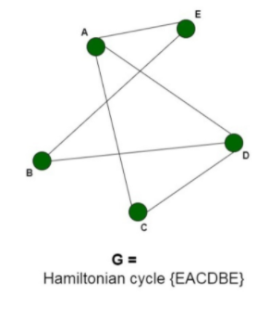
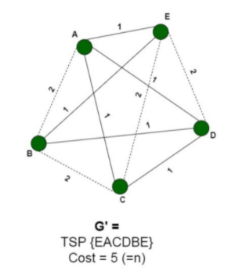
PROOF THAT TSP IS NP-HARD
Explanation –In order to prove the Travelling Salesman Problem is NP-Hard, we will have to reduce a known NP-Hard problem to this problem. We will carry out a reduction from the Hamiltonian Cycle problem to the Travelling Salesman problem.
Every instance of the Hamiltonian Cycle problem consists of a graph G =(V, E) as the input can be converted to a Travelling Salesman problem consisting of graph G’ = (V’, E’) and the maximum cost, K. We will construct the graph G’ in the following way:
For all the edges e belonging to E, add the cost of edge c(e)=1. Connect the remaining edges, e’ belonging to E’, that are not present in the original graph G, each with a cost c(e’)= 2.
And, set K = N.
The new graph G’ can be constructed in polynomial time by just converting G to a complete graph G’ and adding corresponding costs. This reduction can be proved by the following two claims:
Let us assume that the graph G contains a Hamiltonian Cycle, traversing all the vertices V of the graph. Now, these vertices form a TSP with cost = N Since it uses all the edges of the original graph having cost c(e)=1. And, since it is a cycle, therefore, it returns back to the original vertex.
We assume that the graph G’ contains a TSP with cost, K = N. The TSP traverses all the vertices of the graph returning to the original vertex. Now since none of the vertices are excluded from the graph and the cost sums to n, therefore, necessarily it uses all the edges of the graph present in E, with cost 1, hence forming a hamiltonian cycle with the graph G.
Thus we can say that the graph G’ contains a TSP if graph G contains Hamiltonian Cycle. Therefore, any instance of the Travelling salesman problem can be reduced to an instance of the hamiltonian cycle problem. Thus, the TSP is NP-Hard.

Slide 18
NP-COMPLETE
“NP- Complete” comes from:
Nondeterministic Polynomial
Complete- “Solve one, Solve them all”

Slide 19
NP-COMPLETE
The set of NP problems that can be mapped to each other in polynomial time is called NP-Complete.
While we know how to solve many of these algorithms in exponential time, whose to say that one of you bright students won’t come up with a clever polynomial time algorithm!
NP-Complete is useful from that standpoint, if any of them turns out to have a polynomial time algorithm, they all do (hence P=NP).
These problems have been looked at from every angle and no such solution will ever be found (hence, P ≠ NP).
Some well-known problems that are NP-complete when expressed as decision problems : SAT problem, Traveling Salesman problem, Knapsack Problem, Longest Path, Graph Clique.

Slide 20
FLOYD WARSHALL ALGORITHM
Introduction
An algorithm for finding shortest paths in a weighted graph with positive or negative edge weights.
Floyd Warshall Algorithm is an example of dynamic programming approach.
No negative cycles.
Find the lengths of the shortest paths between all pairs of vertices.
The algorithm also known as -
Floyd’s Algorithm
Roy-Warshall Algorithm
Roy-Floyd Algorithm
WFI Algorithm

Slide 21
FLOYD WARSHALL ALGORITHM
Algorithm
for (k = 1; k <= n; k++)
for (i = 1; i <= n; i++)
for (j = 1; j <= n; j++)
{
A_{q}[i, j] = min (A_{q-1}[i, j], A_{q-1}[i, k] + A_{q-1}[k, j]);
}
return A;
n = no of vertices
A = matrix of dimension n*n

Slide 22
FLOYD WARSHALL ALGORITHM
Complexity
Time Complexity :
Floyd Warshall Algorithm consists of three loops over all the nodes. The inner most loop consists of only constant complexity operations.
Hence, the time complexity of Floyd Warshall algorithm is O(n³).
Space Complexity :
The space complexity of Floyd Warshall algorithm is O(n²).

Slide 23
FLOYD WARSHALL ALGORITHM
Advantages
It is extremely simple and easy to implement.
It highlights all the shortest path pairs in a graph with positive or negative edge weights.
It is easy to modify the algorithm and use it to reconstruct the paths.
Disadvantages
It can find the shortest path only when there are no negative cycles.
It does not return the details of the paths.
It works slower than other algorithms designed to perform the same task.

Slide 24
FLOYD WARSHALL ALGORITHM
Application
Shortest path is a directed graph
Transitive closure of directed graphs
Inversion of real matrices
Optimal Routing
Maximum Bandwith Paths
Computing Canonical Form of difference bound matrices
For testing whether an undirected graph is bipartite

Slide 25
FLOYD WARSHALL ALGORITHM
Problem
Consider the following directed weighted graph-
Using Floyd Warshall Algorithm, find the shortest path distance between every pair of vertices.
15
1
4
30
5
5
50
5
15
2
3
15

Slide 26
FLOYD WARSHALL ALGORITHM
Step 1 :
Make a matrix A₀ which stores the information about the minimum distance of path between the direct path for every pair of vertices.
 | 1 | 2 | 3 | 4
1 | 0 | 5 | ∞ | ∞
2 | 50 | 0 | 15 | 5
3 | 30 | ∞ | 0 | 15
4 | 15 | ∞ | 5 | 0
A₀ =

Slide 27
FLOYD WARSHALL ALGORITHM
Step 2 :
In this step, we use A₀ matrix and find the shortest path via 1 as an intermediate node.
A₁[1,1]=0, A₁[2,2]=0, A₁[3,3]=0, A₁[4,4]=0.
A₁[1,2], A₁[1,3], A₁[1,4], A₁[2,1], A₁[3,1], A₁[4,1]
are remain same as in matrix A₀.
A₁[2,3]= min(A₀[2,3], A₀[2,1]+A₀[1,3]) = 15
A₁[2,4]= min(A₀[2,4], A₀[2,1]+A₀[1,4]) = 5
A₁[3,2]= min(A₀[3,2], A₀[3,1]+A₀[1,2]) = 35
A₁[3,4]= min(A₀[3,4], A₀[3,1]+A₀[1,4]) = 15
A₁[4,2]= min(A₀[4,2], A₀[4,1]+A₀[1,2]) = 20
A₁[4,3]= min(A₀[4,3], A₀[4,1]+A₀[1,3]) = 5
 | 1 | 2 | 3 | 4
1 | 0 | 5 | ∞ | ∞
2 | 50 | 0 | 15 | 5
3 | 30 | 35 | 0 | 15
4 | 15 | 20 | 5 | 0
A₁ =

Slide 28
FLOYD WARSHALL ALGORITHM
Step 3 :
In this step, we use A₁ matrix and find the shortest path via 2 as an intermediate node.
A₂[1,1]=0, A₂[2,2]=0, A₂[3,3]=0, A₂[4,4]=0.
A₂[1,2], A₂[3,2], A₂[4,2], A₂[2,1], A₂[2,3], A₂[2,4]
are remain same as in matrix A₁.
A₂[1,3]= min(A₁[1,3], A₁[1,2]+A₁[2,3]) = 20
A₂[1,4]= min(A₁[1,4], A₁[1,2]+A₁[2,4]) = 10
A₂[3,1]= min(A₁[3,1], A₁[3,2]+A₁[2,1]) = 30
A₂[3,4]= min(A₁[3,4], A₁[3,2]+A₁[2,4]) = 15
A₂[4,1]= min(A₁[4,1], A₁[4,2]+A₁[2,1]) = 15
A₂[4,3]= min(A₁[4,3], A₁[4,2]+A₁[2,3]) = 5
 | 1 | 2 | 3 | 4
1 | 0 | 5 | 20 | 10
2 | 50 | 0 | 15 | 5
3 | 30 | 35 | 0 | 15
4 | 15 | 20 | 5 | 0
A₂ =

Slide 29
FLOYD WARSHALL ALGORITHM
Step 4 :
In this step, we use A₂ matrix and find the shortest path via 3 as an intermediate node.
A₃[1,1]=0, A₃[2,2]=0, A₃[3,3]=0, A₃[4,4]=0.
A₃[1,3], A₃[2,3], A₃[4,3], A₃[3,1], A₃[3,2], A₃[3,4]
are remain same as in matrix A₂.
A₃[1,2]= min(A₂[1,2], A₂[1,3]+A₂[3,2]) = 5
A₃[1,4]= min(A₂[1,4], A₂[1,3]+A₂[3,4]) = 10
A₃[2,1]= min(A₂[2,1], A₂[2,3]+A₂[3,1]) = 45
A₃[2,4]= min(A₂[2,4], A₂[2,3]+A₂[3,4]) = 5
A₃[4,1]= min(A₂[4,1], A₂[4,3]+A₂[3,1]) = 15
A₃[4,2]= min(A₂[4,2], A₂[4,3]+A₂[3,2]) = 20
 | 1 | 2 | 3 | 4
1 | 0 | 5 | 20 | 10
2 | 45 | 0 | 15 | 5
3 | 30 | 35 | 0 | 15
4 | 15 | 20 | 5 | 0
A₃ =

Slide 30
FLOYD WARSHALL ALGORITHM
Step 5 :
In this step, we use A₃ matrix and find the shortest path via 4 as an intermediate node.
A₄[1,1]=0, A₄[2,2]=0, A₄[3,3]=0, A₄[4,4]=0.
A₄[1,4], A₄[2,4], A₄[3,4], A₄[4,1], A₄[4,2], A₄[4,3] are remain same as in matrix A₃.
A₄[1,2]= min(A₃[1,2], A₃[1,4]+A₃[4,2]) = 5
A₄[1,3]= min(A₃[1,3], A₃[1,4]+A₃[4,3]) = 15
A₄[2,1]= min(A₃[2,1], A₃[2,4]+A₃[4,1]) = 20
A₄[2,3]= min(A₃[2,3], A₃[2,4]+A₃[4,3]) = 10
A₄[3,1]= min(A₃[3,1], A₃[3,4]+A₃[4,1]) = 30
A₄[3,2]= min(A₃[3,2], A₃[3,4]+A₃[4,2]) = 35
A4 matrix is our final matrix which tells us the minimum distance
between two vertices for all the pairs of vertices.
 | 1 | 2 | 3 | 4
1 | 0 | 5 | 15 | 10
2 | 20 | 0 | 10 | 5
3 | 30 | 35 | 0 | 15
4 | 15 | 20 | 5 | 0
A₄ =

Slide 31
DISJOINT SETS
Two sets are said to be disjoint if there are no common elements in them.
Set Id : 0, elements : [0,1,2,3]
Set Id : 4, elements : [4,5]
Uses of Disjoint Sets
Keep track of the set that an element belongs to.
Finding a cycle in a graph.
1
3
0
5
Disjoint Sets
2
4

Slide 32
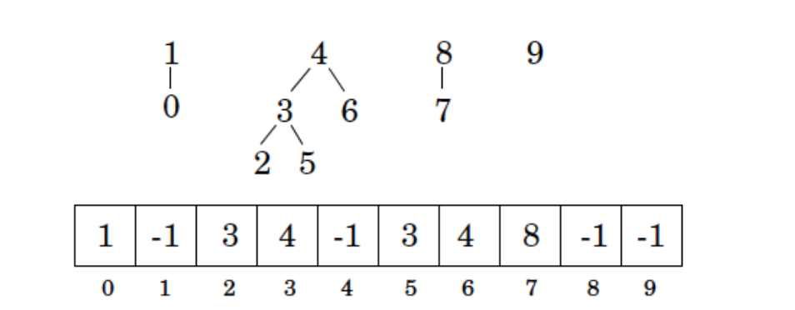
DISJOINT SETS
Representation
Disjoint Sets use chaining to define a set.
An array of integers, called parent[ ]. If we are dealing with n items, i’th element of the array represents the i’th item. More precisely, the i’th element of the array is the parent of the i’th item.
It is a disjoint set. If two elements are in the same tree, then they are in the same disjoint set. The root node of each tree is called the representative of the set.

Slide 33
THANK YOU
Presented By
Shivam Yadav (1906505)
Souhardya Pal (1906511)
Souraja Dasray (1906513)
Swapnil Acharya (1906519)
Alankrita Shandilya (1906528)
Ankit Raj (1906534)
Anupam Maity(1906537)
Anusha Gupta(1906539)

